Slide 1



Slide 2

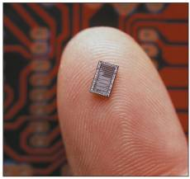
Describe the six basic types of system units.
Discuss how a computer can represent numbers and encode characters electronically.
Describe each of the major system unit components.
Discuss microprocessors,
including microprocessor
chips and specialty processors.
Discuss memory including
RAM, ROM, and flash memory.

Slide 3

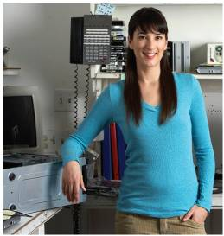
Speed, capacity, and flexibility determine the power of microcomputers.
Knowledge of a computer’s power allows you to make good buying decisions and to determine if your current system will run new applications.
Competent end users need to
understand the basic principles
of how microcomputers are
put together.

Slide 4

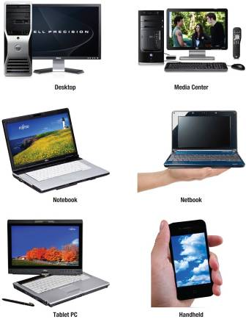
Desktop System Units
Media Center System Units
Notebook System Units
Netbook System Units
Tablet PC System Units
Handheld Computer
System Units
Notes:
System unit is also referred to as the system chassis(Key Term)
All computers have a system unit
Desktop – contains electronic components and selected secondary storage
Media center – use powerful desktop system hardware with specialized graphic cards for interfacing with TVs
Notebook – contains electronic components, secondary devices, and input devices – often called laptop computers (Key Term)
Netbook – like notebooks, but less powerful and less expensive, used for web browsing and email
Tablet PC (Key Term) –
2 Types
Notebook computer that supports the use of a stylus or pen to input commands and data
Slate tablet PC– similar to notebook but monitor is attached to the system unit and does not have an integrated keyboard, uses mobile OS, accepts gesture input, can display movies, mainly designed to display content
Hand-held computer systems
Personal digital assistants (Key Term) (PDAs) and smartphones– electronic components, secondary storage, input/output devices
Palm computers - contain an entire computer system

Slide 5

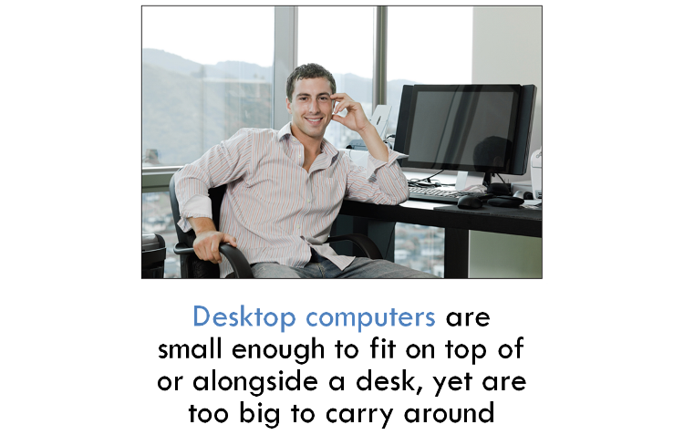
Return

Slide 6

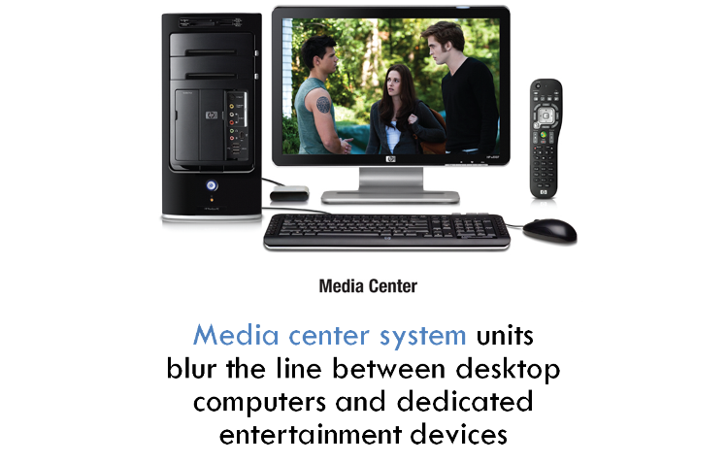
Return

Slide 7

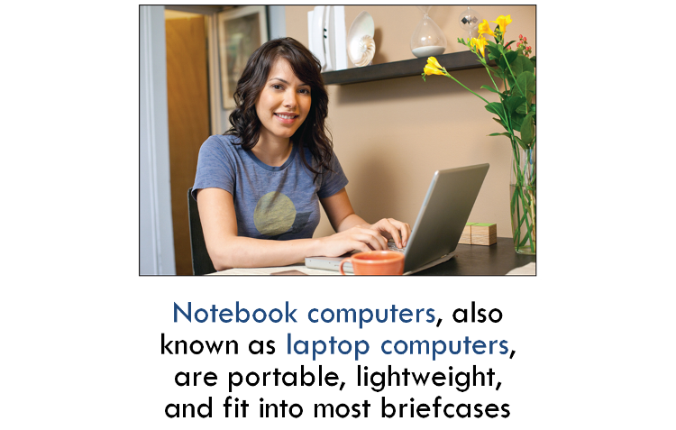
Return

Slide 8

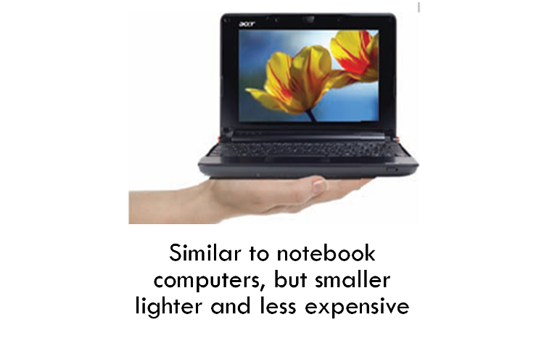
Return
Notes:
Discuss the limitations of netbooks.

Slide 9

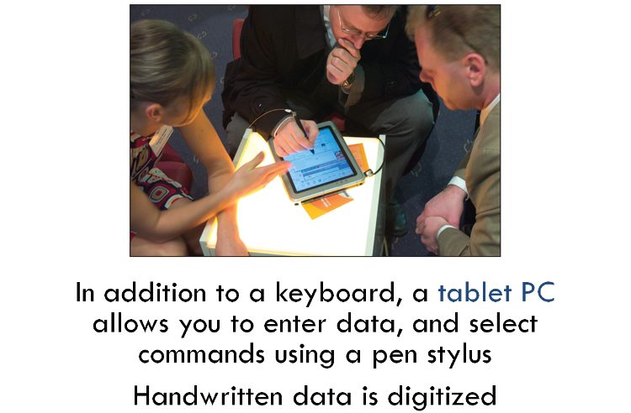
Return
Notes:
Accepts handwriting
Digitized data is converted to standard text that can be further processed by a word processor.
Ask students if they are familiar with tablet PCs like the iPad.

Slide 10

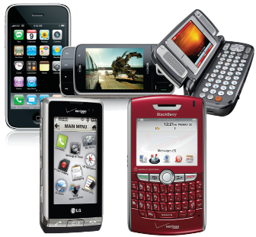
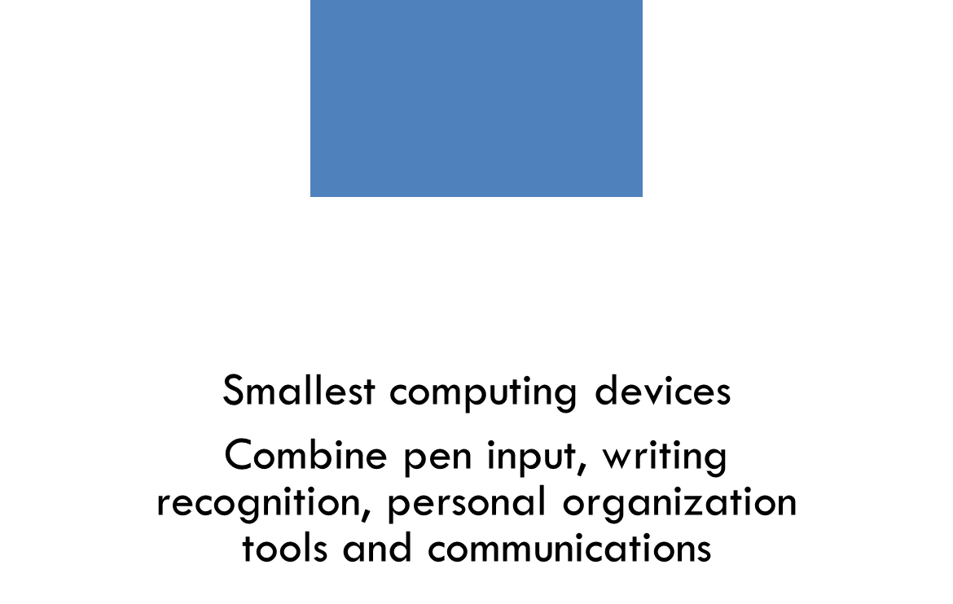
Return
Notes:
Handheld or palm computers, such as Personal digital assistants (PDAs) and smartphones, are amongst the smallest computing devices
These systems typically combine pen input, writing recognition, personal organizational tools, and communications capabilities
Smartphones are cell phones with wireless connections to the Internet

Slide 11

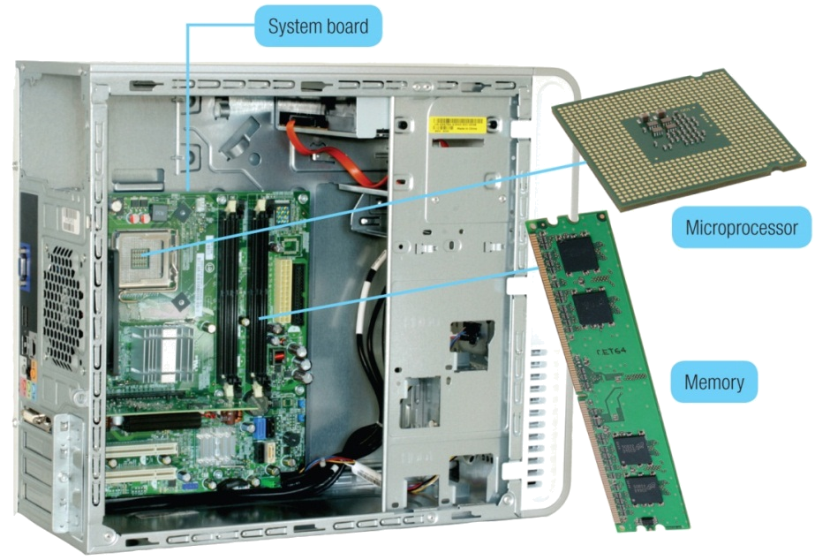
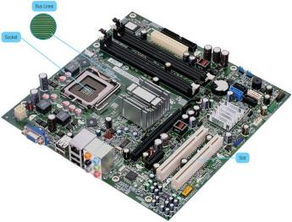
System Chassis
System board
  Motherboard
Microprocessor
Memory
Socket
Bus lines
Expansion slots
Notes:
Also known as the system chassis is a container that houses most of the electrical components that make up a computer system.

Slide 12

Data and instructions are represented electronically
Two-state system or Binary System
  Off/on electrical states
  Characters represented by 0’s (off) and 1’s (on)
  Bits
  Bytes
Notes:
Our voices recognize analog (Key Term) signals
Continuous signals
Computers only recognize digital (Key Term) signals
Electrical
On/off state
The binary system consists of two digits – 0 and 1
Each 0 or 1 is called a bit – short for binary digit
Bits are combined into groups of eight bits called bytes
Smallest character = bit; eight bits = 1 byte or one character

Slide 13

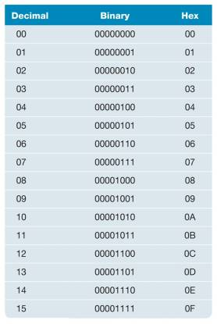
Binary coding schemes
  ASCII - American Standard
  Code for Information Exchange
  EBCDIC - Extended Binary
  Coded Decimal Interchange
  Code
  Unicode - handles languages
  with large numbers of characters
Notes:
Knowing this information helps understand what takes place when data entered into computer – why it takes time for the data to get transformed
Three basic schemes of coding
ASCII – primarily desktop
EBCDIC – primarily mainframe and super
Unicode – to handle languages with large numbers of characters

Slide 14

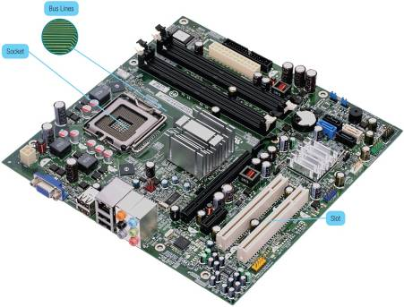
Main board or motherboard
Controls communications
Components connect to the system board
Data path
Traffic monitor
Notes:
Includes sockets, slots and bus lines

Slide 15
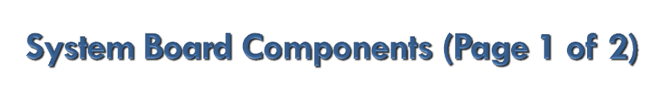

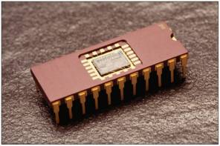
Sockets
  Connection
  point for
  chips
Chips
  Tiny circuit boards etched onto squares of silicon
  Silicon chip, semiconductor, or integrated circuit
  Mounted on carrier packages
Notes:
Chips contain numerous circuits etched on a small wafer of layers of silicon and other materials
Chips are mounted on carrier packages (Key Term)
Chips are also referred to as a silicon chip (Key Term), semiconductor (Key Term), or integrated circuit (Key Term)

Slide 16

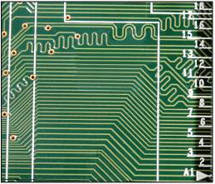
Slots
  Provide a connection point for specialized cards or circuit boards
Bus lines
  Provide pathways that support communication among the various electronic components

Slide 17

Central Processing Unit (CPU)
  Contained on the microprocessor chip
  Brains of the computer
Two Basic Components
  Control unit
  Arithmetic-logic unit (ALU)
Notes:
CPU or processor located on the microprocessor chip and has two components - the control unit and the arithmetic-logic unit
Control Unit
Program instructions
Directs flow between memory and Arithmetic-Logic Unit
Directs flow between CPU and I/O devices
Arithmetic-Logic Unit - ALU
Two types of operations
Arithmetic operation (Key Term)
Logical operation (Key Term)

Slide 18

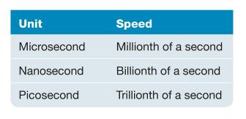
Chip capacities expressed in word size
Word
  The number of bits that can be processed at one time
  64-bit standard
Clock Speed
  Processing speed
  The number of times the CPU fetches and
  processes data or instructions in a second
Notes:
A word (Key Term) is the number of bits that can be accessed at one time by the CPU
32 bit word computer can access 4 bytes at a time
64 bit word computer can access 8 bytes at a time

Slide 19

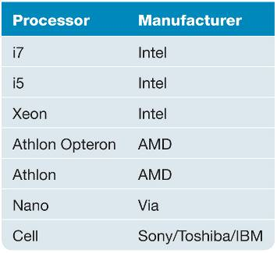
  Multi-Core Chip
    Two separate and independent CPUs
    Parallel Processing
    Windows 7 and Mac OS X
Notes:
Multicore chip – allow a single computer to run two or more operations at the same time
Example: A dual-core process could have one core computing a complex Excel spreadsheet while the other is running a multimedia presentation.
Parallel Processing – dividing tasks into parts that can be distributed across each core

Slide 20

Coprocessors
  Designed to improve specific computing operations
  Graphics coprocessors / Graphics Processing Unit (GPU)
Smart cards
  Credit card with an embedded chip
Specialty processors in cars:
RFID tags
  Information chips
  Embedded in merchandise to track their location
Notes:
Specialty processors are designed to handle special functions
Graphics coprocessor, Graphics Processing Unit
Displaying 3-D images and encrypting data
Smart cards (and readers)
Plastic cards that have an embedded chip
Can store 80 times the information stored on the magnetic strip of a regular credit card
RFID tags
Used by luxury car manufacturers for fuel efficiency, tracking, and satellite entertainment

Slide 21

Holding area for data, instructions, and information
Chips connected to the system board
RAM
  Random Access Memory
ROM
  Read Only Memory
Flash
Notes:
RAM (Random-access memory) (Key Term)
ROM (Read-only memory) (Key Term)
Flash (Key Term) - a kind of memory that retains data in the absence of a power supply.

Slide 22

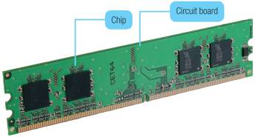
Random Access Memory (RAM) chips hold programs and data that are currently being accessed
  Volatile
  Cache memory or RAM cache
Additional RAM can be added using an expansion module called a DIMM
Other types of RAM
  DRAM
  SDRAM
  DDR
  Direct RDRAM
Return
Notes:
Temporarily holds data and programs being processed by the CPU
Volatile - when power shuts off, contents of RAM are emptied
Exception - flash RAM can retain data when power disrupted, used in high end portable computers
Cache memory – improves processing by acting as a temporary high-speed holding area between the memory and CPU
Area in RAM set aside to store information frequently accessed
Acts as a high-speed, temporary holding area for parts of programs and data
Results in faster processing results for the user
Flash memory – can retain data even if the power is disrupted
Most expensive type of RAM
Used for digital telephones, digital video cameras, and portable computers
Virtual Memory (Key Term) – large programs are divided into parts and the parts are stored on a secondary device, usually a hard disk. Each part is then read into RAM only when needed
RAM is also referred to as temporary or volatile storage
It is a good idea to save your work in progress to a second a secondary storage device. which is permanent or nonvolatile storage

Slide 23

Read-only memory (ROM)
  Information stored by the manufacturer
  Non-volatile and cannot be changed
CPU can read, or retrieve data and programs in ROM but the computer cannot change ROM
Contain special instructions
  Start the computer
  Access memory
  Handle keyboard input
Return

Slide 24

Flash memory offers a combination of the features of RAM and ROM
Like RAM, it can be updated
Like ROM, it is non-volatile
Contains startup information
  Amount of RAM
  Type of keyboard, mouse, and secondary storage devices connected
Return

Slide 25

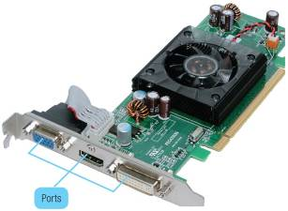
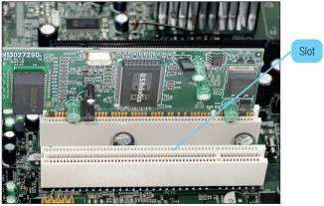

For adding devices
Plug and play
ExpressCard slots
  PCMCIA slots
  Notebooks and handheld devices
Notes:
Expansion slots provide an open architecture
Expansion cards provide network connections, PC/TV combinations, and more
This open architecture allows users to expand and update their systems
Devices to meet these needs, expansion cards, are inserted into the expansion slots
A closed architecture card relies on a proprietary add-on, often at more expensive prices
Most devices are plug and play which means the user does not have to install a device driver
PC cards - credit card-sized expansion cards for portable computers, also known as PCMCIA (Personal Computer Memory Card International Association) cards

Slide 26

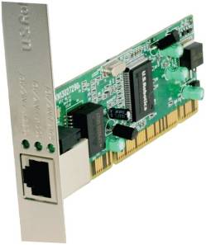
Advanced graphics cards
Sound cards
Network interface cards (NIC)
Wireless network cards
TV tuner cards
Notes:
Graphics cards - connect the system board to the monitor; convert internal electronic signals to video signals
Sound cards – convert electronic signals to audio signals and accept audio input from microphones
Network Interface Cards - (Key Term) (NICs or Network Interface Cards) - connect system unit to a cable (Key Term) attached to a network
Wireless network cards – allow computers to be connected without cables
TV turner cards (Key Term) – converts TV video signal for viewing on computer monitor

Slide 27

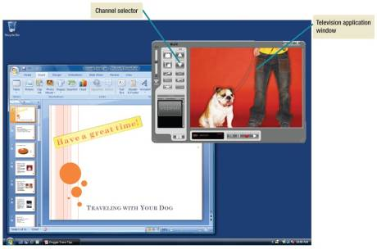
Allows you to view your favorite TV shows while running other applications such as Excel
Video can be captured to a file, added to a Web page, attached to an email, or added to a presentation
Inexpensive and
easy to install
Notes:
Factors that could limit the performance
Speed of the processor
Amount of memory
Secondary storage capacity
TV tuner card - a kind of television tuner that allows television signals to be received by a computer. Most TV tuners also function as video capture cards, allowing them to record television programs onto a hard disk much like the digital video recorder (DVR) does.

Slide 28

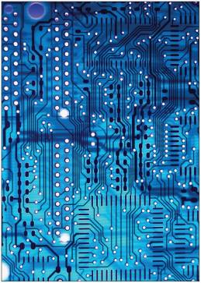
Also known as a bus
Connect parts of the CPU to each other
Pathway for bits
Bus width
  Number of bits that
  can travel at once
Two basic categories
  System buses
  Expansion buses
Notes:
Bus lines provide data pathways that connect various system components
A bus line is also called a bus (Key Term)
It is a pathway for bits representing data and instructions
A bus is similar to a multilane highway.
Every computer has two basic categories of buses
System – connects the CPU to memory on the system board
Expansion – connects the CPU other components and to slots on the system board

Slide 29

Connects the CPU to other components on the system board, including expansion slots
Universal Serial Bus (USB)
  Connects external USB devices onto the USB bus
FireWire
  Audio and video equipment
PCI Express (PCIe)
  Single dedicated path for each connected device
Notes:
FireWire buses – similar to USB but more specialized.
used primarily to connect audio and video equipment to the system board
PCI Express – widely used in many of today’s most powerful computers; provides a single dedicated path for each connected device (unlike other buses which share a single bus line or path with several devices.

Slide 30

Socket for connecting external devices
Ports can connect directly to the system board or they can connect to cards that are inserted into slots on the system board
Three Types
  Standard Ports
  Specialized Ports
  Legacy Ports
Notes:
Ports are connecting sockets on the outside of a system unit
Ports are often standard features of computer systems and others are more specialized

Slide 31

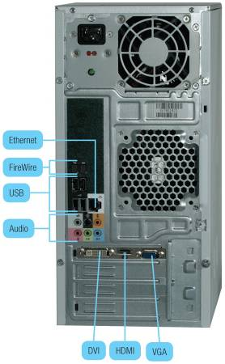
VGA and DVI
  Analog and digital monitors
USB
  Keyboards, mice, printers,
  storage devices
FireWire
  High speed
Ethernet
  High speed networking
Return
Notes:
VGA (Video Graphics Adapter) and DVI (Digital Video Interface)
USB (universal serial bus)
FireWire ports also known as high performance serial bus (HPSB) ports – for high-speed printers and video cameras
Ethernet – standard for networking, allows you to connect multiple computers for sharing files, or to a DSL or cable modem for internet access

Slide 32

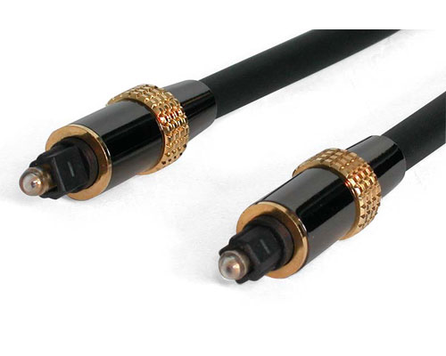
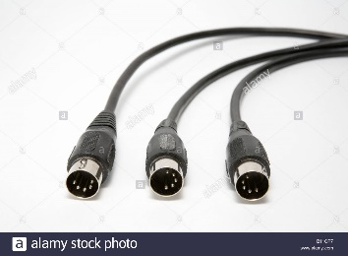
Sony/Philips Digital Interconnect Format (S/PDIF)
  Optical audio connections
  High end audio and home theatre
High Definition Multimedia Interface (HDMI)
  High definition video and audio
Musical Instrument Digital Interface (MIDI)
  Connect musical instruments
Return

Slide 33

Old types of ports mostly replaced by faster, more flexible ports such as USB
  Serial
  Parallel
  Keyboard and mouse
    Infrared Data Association (IrDA)
    Game
Return
Notes:
Serial ports – data transported one bit at a time; mouse, keyboard, modem, etc.
Parallel ports – for external devices needing lots of data over short distances, like printers, scanners, external Zip drives
Keyboard and mouse
IrDA – were used to provide wireless mechanisms for transferring data between devices; for example, transferring data from a handheld to a desktop
Game – video game controllers and joysticks

Slide 34

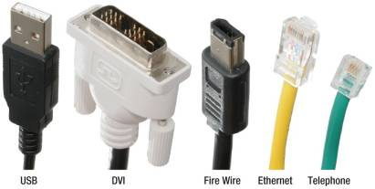
Used to connect external devices to the system unit via the ports
One end of the cable is attached to the device and the other end has a connector that is attached to a matching connector on the port

Slide 35

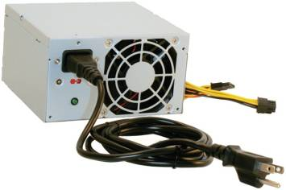
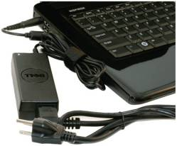
Computers require direct current (DC)
DC power provided by converting alternating current (AC) from wall outlets or batteries
Desktop computers use power supply units
Notebooks and handhelds use AC adapters
Notes:
Direct current (DC) powers computers
Desktop computers have a power supply unit located within the system unit
Notebook computers use AC adapters that are located outside the system unit
Netbook and handheld use AC adapters

Slide 36

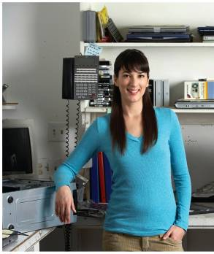
Computer technicians repair and install computer components and systems
Employers look for:
  Certification
  Communication skills
Continued education
is required
Computer technicians can
expect to earn an hourly
wage of $13.50 to $22.50
Notes:
Opportunities for advancement typically come in the form of work on more advanced computer systems
Some computer technicians move into customer service positions or go into sales

Slide 37

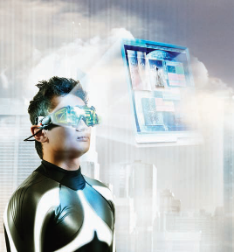
Wearable computers
Send and receive email while jogging
Maintain your personal schedule book
Remember the names of people at a party
Notes:
Wearable computers already exist for the military
In the future, will be used by surgeons in operating rooms

Slide 38

Describe the six basic types of system units. What is the difference between a traditional and a slate tablet PC?
Discuss electronic data and instructions including numeric representation and character encoding.
Describe system boards including sockets, chips, carrier packages, slots, and bus lines.

Slide 39

Discuss microprocessors including the two basic components, words, clock speed, multicore chips, and specialty processors.
Define computer memory including RAM, cache, DIMM, virtual memory, ROM, and flash memory.

Slide 40

Define expansion slots and cards and discuss five commonly used expansion cards. What is Plug and Play? What are PCMCIA slots and ExpressCard slots?
Describe bus lines including bus width, system bus, expansion bus, and three types of buses.

Slide 41

Define ports including standard, specialized, and legacy ports. Give examples of each.
Describe power supply including power supply units and AC adapters.

